Slide 1
Australian Bushfires

Slide 2
In this lesson, we will focus on bushfires. By the end of the lesson, you should be able to:
1. | Identify the causes of bushfires.
2. | Explain how bushfires affect humans.
3. | Explain how bushfires affect ecosystems.

Slide 3


Slide 4
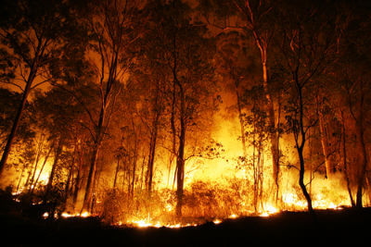
Australia is the driest inhabited continent on Earth.
This makes it prone to fires, which may be started naturally by lightning, or by human activities.
Once a bushfire starts, environmental conditions can make it difficult to contain. In the spring of 2013, New South Wales was experiencing record high temperatures and very low rainfall. Both these factors left the forests dry and hot, so a fire was almost inevitable.

Slide 5
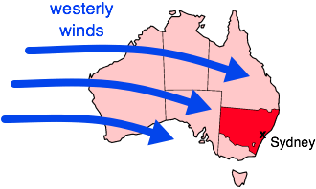
The weather can make things worse.
To make matters worse, westerly winds brought hot, dry air from across the outback to fuel those fires and push them toward Sydney. The end result was the worst bushfires in the state for 50 years.

Slide 6
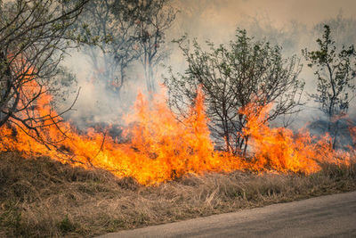
Bushfires can have devastating consequences.
For humans, this includes the loss of life and damage to property. There is also impacts on ecosystems.
For example, forest habitats are burnt and many organisms die or are forced to move somewhere else (migrate).

Slide 7
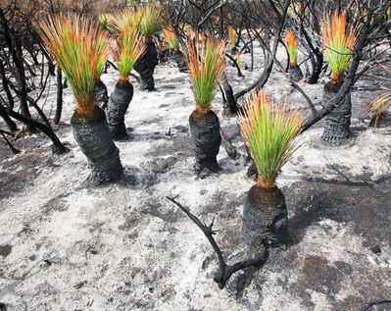
Even though bushfires can be devastating, they also have some benefits!
Bushfires clear away undergrowth and create finer soil, both of which allow for new plant growth.

Slide 8
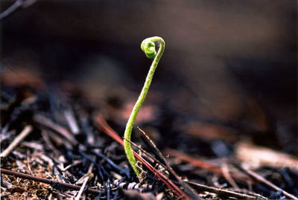
For Example:
Bushfires can damage or destroy mature (old) trees, making the wood we take from them useless. This wood would otherwise be used for timber in buildings or as firewood.
Old growth also plays an important role in carbon capture and stabilising the global climate. Burning these trees releases vast amounts of carbon into the atmosphere!
On the other hand, burning releases nutrients stored in the wood, which then accumulate in the soil. These nutrients support the next generation of plants that sprout and regenerate the forest.

Slide 9
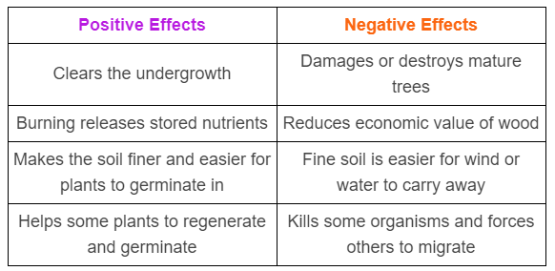
The following table summarises the positive and negative effects of bushfires:

Slide 10
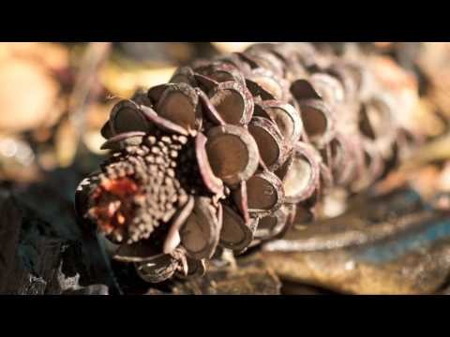

Slide 11
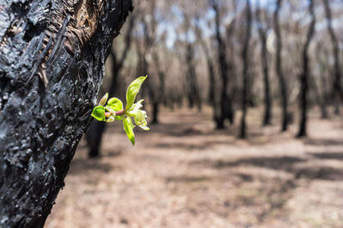
Plants and bushfires:
The plants in a forest can't move away from a bushfire, so they have other adaptations to help them survive these events.
Some trees, including gum trees, have epicormic buds located deep under their bark. Even if the outside of the tree is scorched during a bushfire, these buds can survive. After the fire, they sprout and revive the burnt tree.

Slide 12
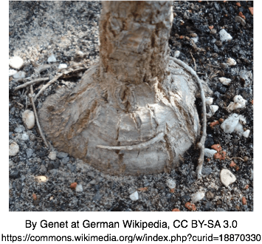
Lignotubers are the next adaptation we'll look at.
A lignotuber is a large swelling in the base of a tree, like a bulge at the bottom of its trunk. This feature insulates the bottom of the trunk and the tree's roots from fire. After the fire has passed, new branches quickly sprout from the lignotuber and regenerate the tree.

Slide 13
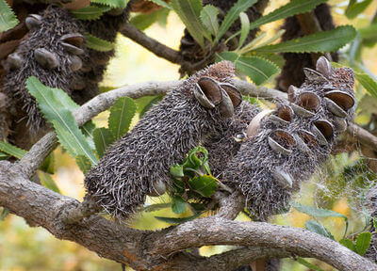
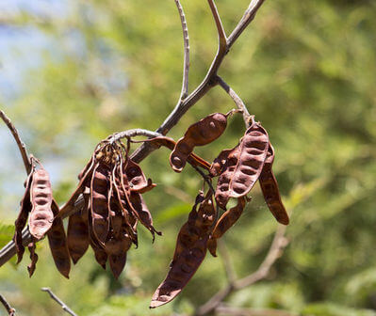
Over time, plants in the Australian bush have developed adaptations to help them cope with bushfires.
Some species take it a step further - they actually need fire to reproduce.
Banksias and acacias have special capsules that hold their seeds. They only open after being exposed to fire, dropping the seeds into the soil below.

Slide 14
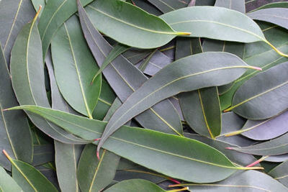
Many eucalypts seem to invite being burned by a bushfire.
As you might expect, they have epicormic buds and lignotubers to help them regenerate.
However, these trees actually help fire to spread, because their leaves contain flammable oils. Also their bark peels easily, forming dry sheets that hang down to the ground, almost like candle wicks.
These are clever techniques to promote growth of eucalypts, but they're also among the reasons the bushfires in 2013 expanded so quickly.

Slide 15
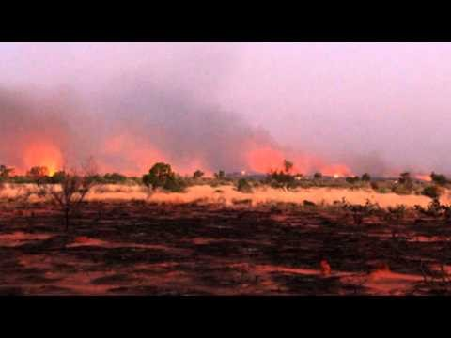
Firestick farming is an old method used by Indigenous Australians to manage the land.

Slide 16
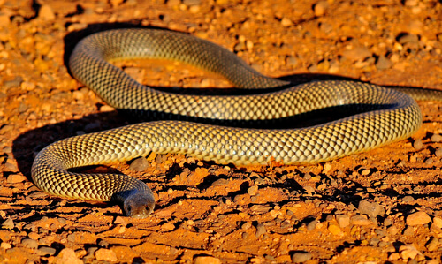
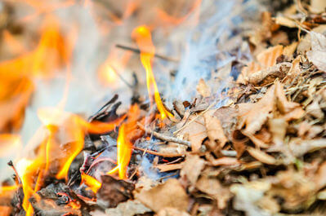
Firestick farming provides many advantages to Aboriginal people.
For instance, the smoke from the fires would cause burrowing animals to leave their hiding spots, so they could then be hunted.
It also drove away snakes and other dangerous animals.

Slide 17
Regular firestick farming reduced the impact of natural bushfires.
Bushfires could not become as intense or be as frequent if the flammable undergrowth had already been removed.
Plants that had adaptations to regenerate quickly after a fire became more common in Australian ecosystems, because competing plants were literally burned away.

